Slide 1
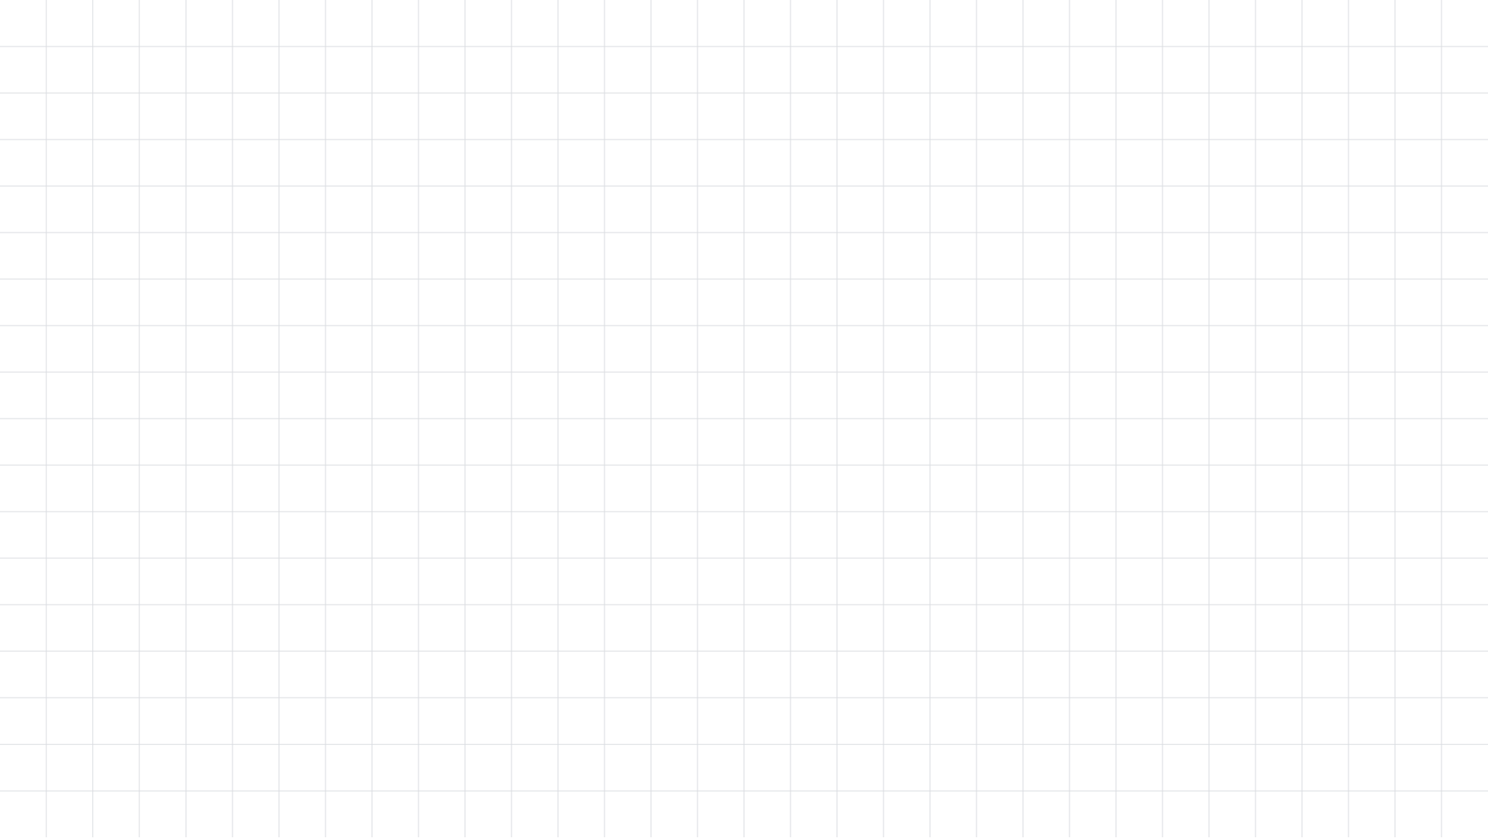

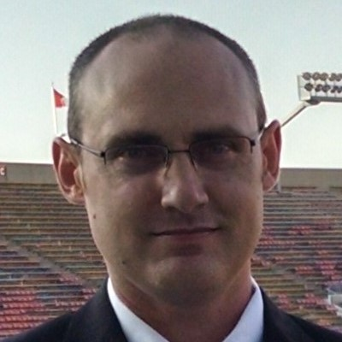
ML Summit ‘20
Computer Vision with the Raspberry Pi
Evan Hennis
Eckron Software
@TheNurl
#MLSummit

Slide 2
Social Media Guidelines
The hashtag for the event is #MLSummit
Join the conversation with Google Developers by mentioning @GoogleDevs in your post along with hashtag #MLSummit

Slide 3



Bio
BS from Iowa State 2004
MS from Georgia Tech 2018
C# developer since 2004
GDE in Machine Learning 2019

Slide 4
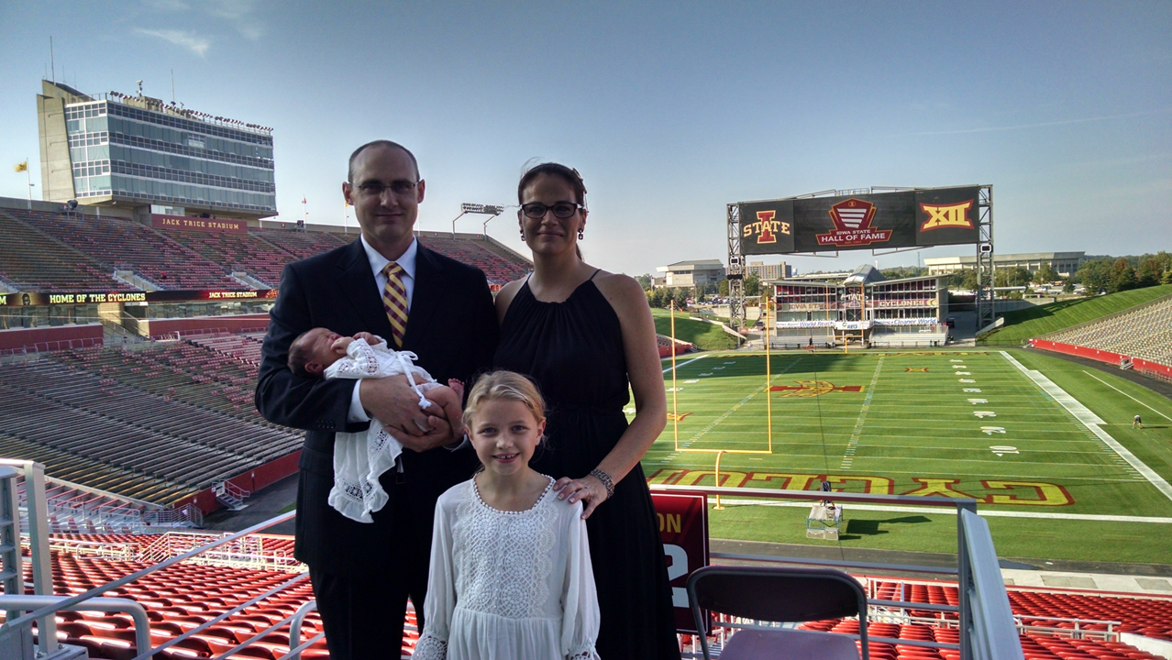

Slide 5
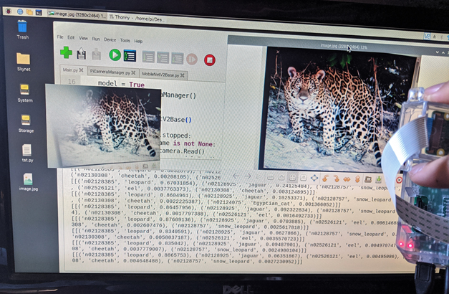
Overview
Project Introduction
Raspberry Pi Setup (SD and OS)
Camera and API
TensorFlow v2 on ARM
MobileNetV2
Code and Demo
TensorFlow Lite Update
Future Projects
Conclusions

Slide 6
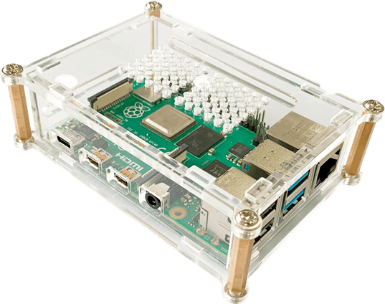
Project Introduction
Raspberry Pi 3
Raspbian (Now Raspberry Pi OS)
Raspberry Pi Camera
Module V2-8 Megapixel
Leigh Johnson (@grepLeigh)

Slide 7
Raspberry Pi Setup (SD, OS, Camera)
SD Card
>= 8GB
Raspberry Pi Imager (Windows)
Don’t:
>32 GB
Write protect your card
Raspberry Pi OS (Former Raspbian) or Noobs

Slide 8
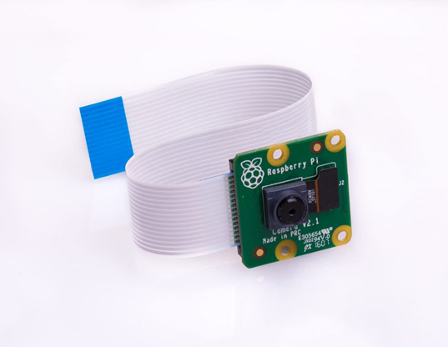
Camera and API
Camera: V2 8 Megapixel
API: PiCamera
sudo apt install python3-picamera

Slide 9
TensorFlow v2 on ARM
TensorFlow v2 doesn’t support ARM
TensorFlow Lite is preferred going forward
I will demonstrate the difference later
TensorFlow v2 ARM WHL: https://github.com/lhelontra/tensorflow-on-arm/releases

Slide 10
MobileNetV2
Built into Keras
tensorflow.keras.application.mobilenet_v2
Version 3 is out

Slide 11
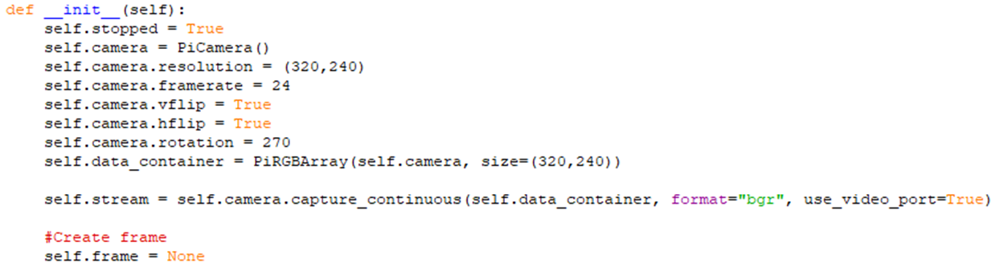
Camera Code (Initialization)

Slide 12
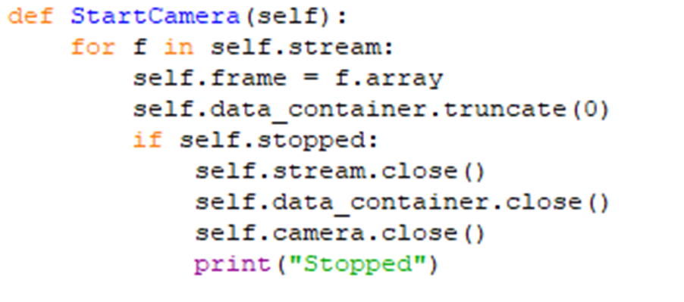
Camera Code (Stream)

Slide 13
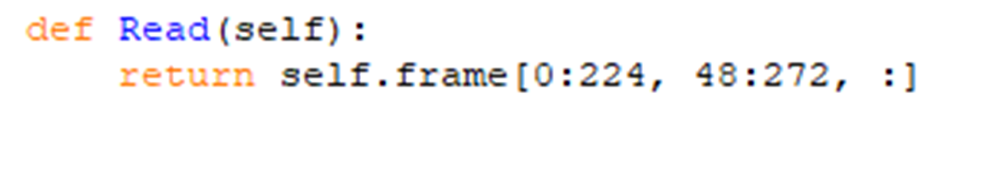
Camera Code (Read)

Slide 14
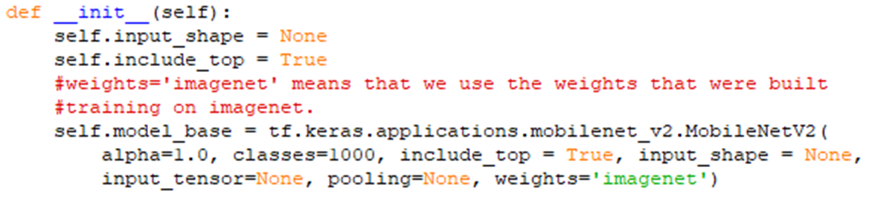
MobileNet (Initialize)

Slide 15
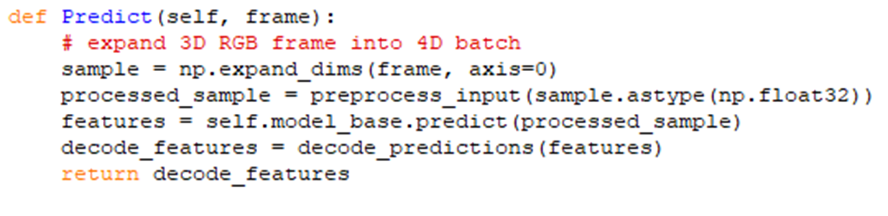
MobileNet (Predict)

Slide 16
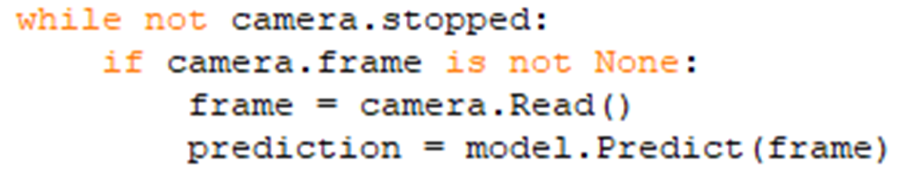
Main

Slide 17

Demo

Slide 18
TensorFlow Lite
Convert Keras model to TF Lite Model
Install TensorFlow Lite Subset
Create TF Lite Interpreter

Slide 19
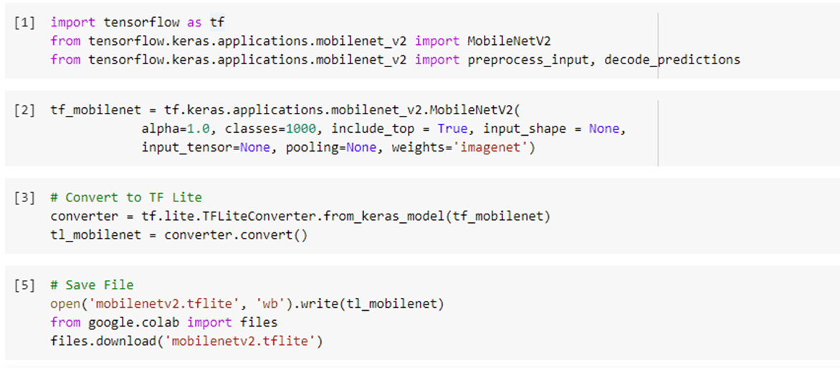
TensorFlow Lite (Model Conversion)

Slide 20
TensorFlow Lite (Install)
Follow Guide: https://www.tensorflow.org/lite/guide/python
For the Raspberry Pi
pip install https://dl.google.com/coral/python/tflite_runtime-2.1.0.post1-cp37-cp37m-linux_armv7l.whl

Slide 21
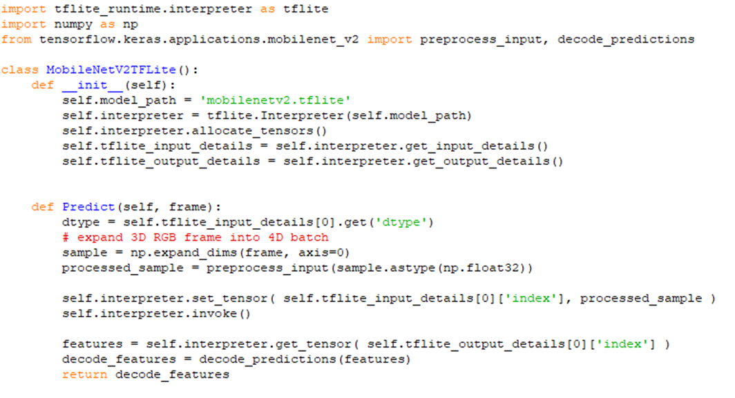
TensorFlow Lite (TF Lite Interpreter)

Slide 22
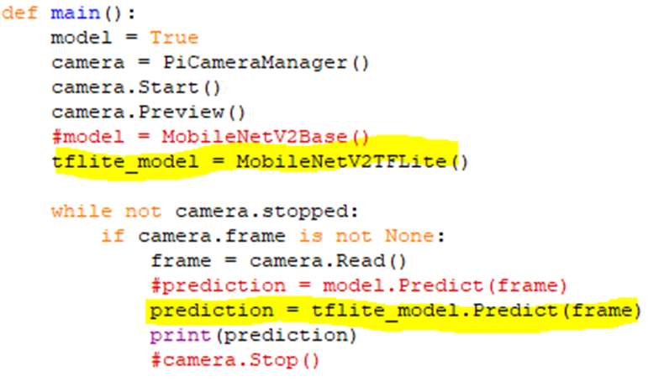
TensorFlow Lite (TF Lite Main)

Slide 23
Future Projects
Use transfer learning and train on a subset of images
Family pictures, cars, etc.
Implement object tracking for security cameras
Add to an automated home to turn on the lights when you show up
Really dumb project but someone online added a Pi to a clock and it would jump off the wall when someone looked at it
Anything...

Slide 24
Conclusion
Simple (Pretrained model, easy install, and quick results)
Cheap ($35 Pi, $30 camera, $ SD card)
Easy (I was able to do it)

Slide 25
Links
Leigh Johnson’s Project: https://towardsdatascience.com/portable-computer-vision-tensorflow-2-0-on-a-raspberry-pi-part-1-of-2-84e318798ce9
Camera Api: https://picamera.readthedocs.io/en/release-1.13/
TensorFlow 2 ARM WHL: https://github.com/lhelontra/tensorflow-on-arm/releases
MobileNetV2 Paper: https://arxiv.org/abs/1801.04381
MobileNet Classes: https://gist.github.com/yrevar/942d3a0ac09ec9e5eb3a
Code Repository: https://github.com/ehennis/Blog/tree/master/ImageDetection

Slide 26
My Information
Twitter: @TheNurl
GitHub: https://github.com/ehennis
YouTube: Evan Hennis
Blog: http://blog.eckronsoftware.com
Email: EvanHennis@gmail.com
Manning liveProject: https://www.manning.com/liveproject/using-deep-learning-to-predict-basketball-scores

